Slide 1

Cellular Automata on Graphs
Presented by
Vikrant Singh
Roll no. 2023ITM011
Under the Guidance of
Dr. Sukanta Das
Department of Information Technology
IIEST, Shibpur

Slide 2
Content
Introduction
Survey on Cellular Automata
CA on Cayley Tree
The Future Work and Discussion
References

Slide 3
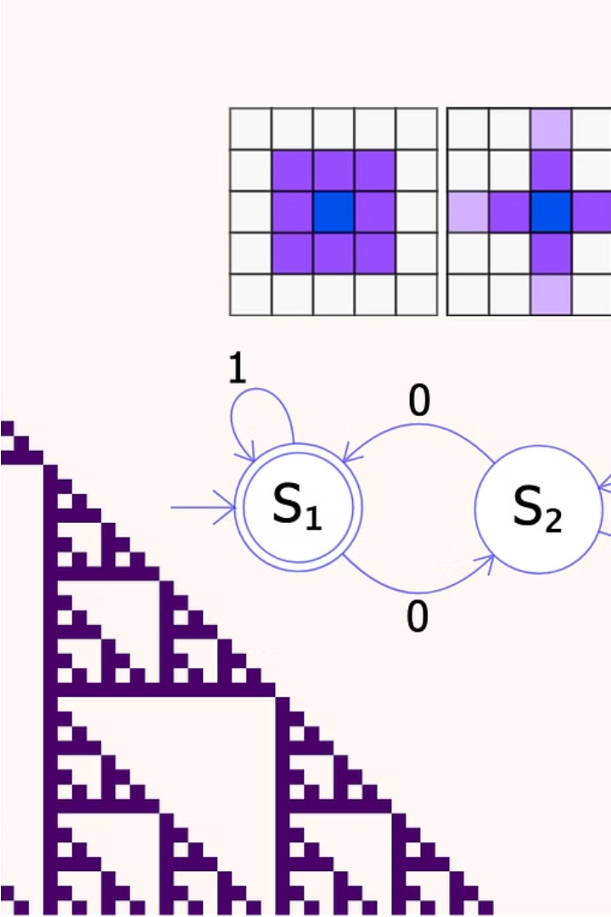
Introduction
What is Cellular Automaton?
Cellular automata are mathematical models that simulate the dynamic behavior of complex systems.
They consist of a grid of cells, each with a set of rules that determine how it changes state over time based on the states of its neighboring cells.

Slide 4
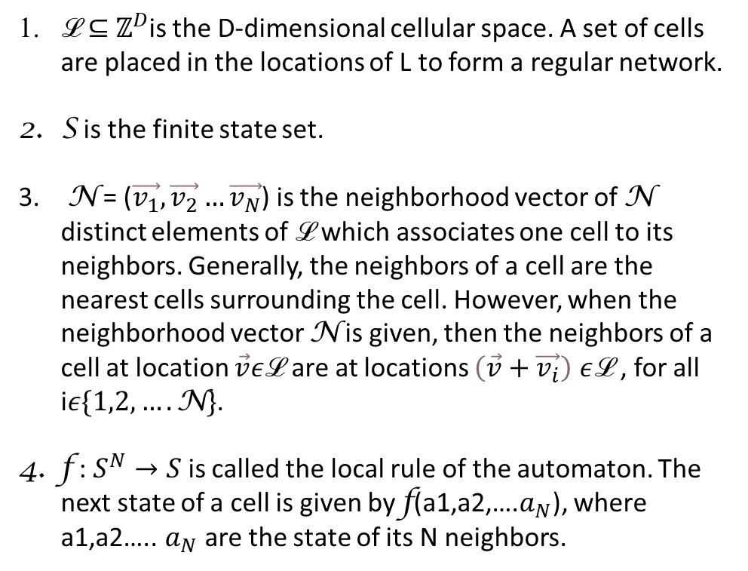
Survey on Cellular Automata
What is Cellular Automaton?
A quadruple (ℒ, S, N, f )
ℒ $⊆$ $ℤ^{D}$is the D-dimensional cellular space. A set of cells are placed in the locations of L to form a regular network.
S is the finite state set.
N = ($\vec{v_{1}},\vec{v_{2}}…\vec{v_{N}}$) is the neighborhood vector of N distinct elements of ℒ which associates one cell to its neighbors. Generally, the neighbors of a cell are the nearest cells surrounding the cell. However, when the neighborhood vector N is given, then the neighbors of a cell at location $\vec{v}ε$ℒ are at locations $\left(\vec{v}+\vec{v_{i}}\right)$ $ε$ℒ , for all i$ε\{1,2,….\text{N}\}$.
f : $S^{N}→S$is called the local rule of the automaton. The next state of a cell is given by f(a1,a2,….$a_{N}$), where a1,a2….. $a_{N}$ are the state of its N neighbors.

Slide 5
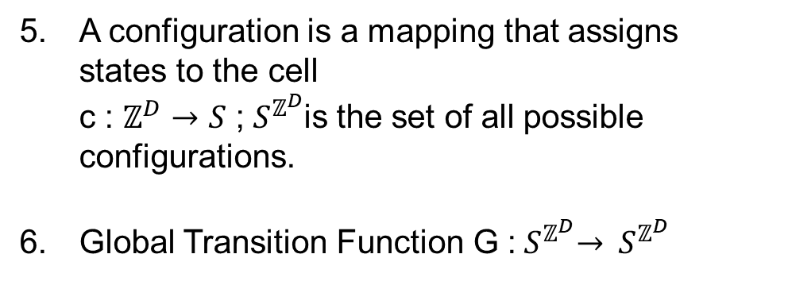
Survey on Cellular Automata
What is Cellular Automaton?
A quadruple (ℒ, S, N, f )
A configuration is a mapping that assigns states to the cell c : $ℤ^{D}→S$ ;${ S}^{ℤ^{D}}$is the set of all possible configurations.
Global Transition Function G :${ S}^{ℤ^{D}}→ { S}^{ℤ^{D}}$

Slide 6
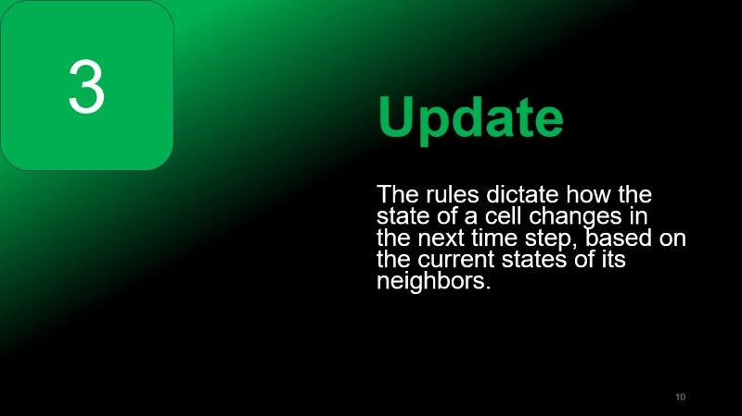
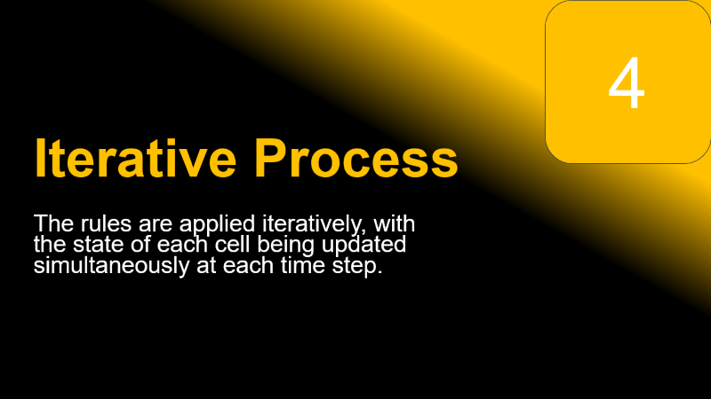
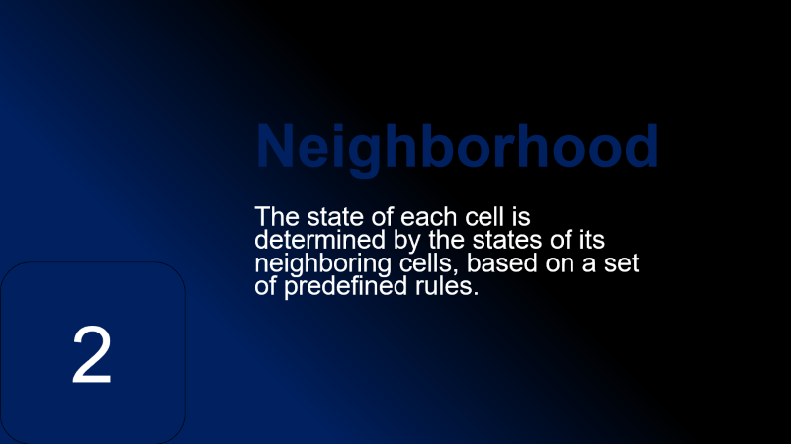
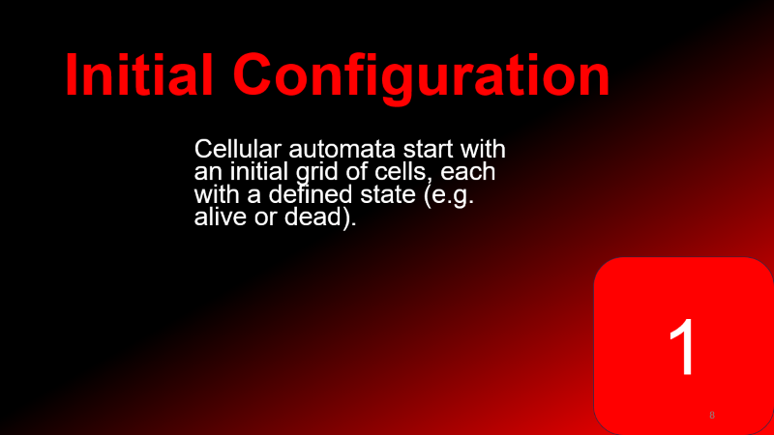



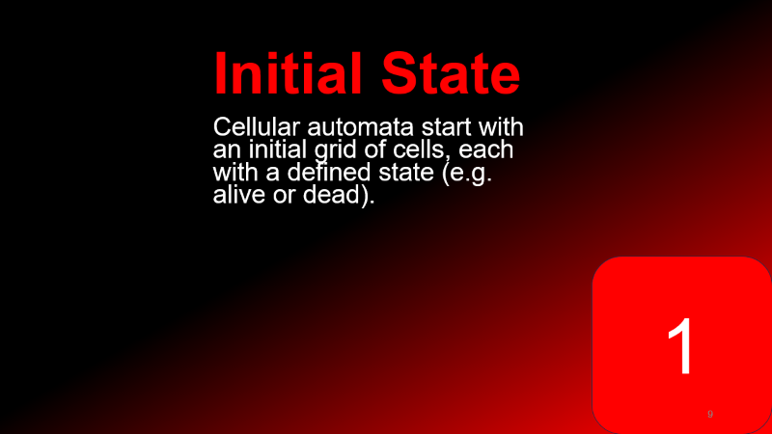

Slide 7




Slide 8
Initial Configuration
Cellular automata start with an initial grid of cells, each with a defined state (e.g. alive or dead).
1

Slide 9
Neighborhood
The state of each cell is determined by the states of its neighboring cells, based on a set of predefined rules.
2

Slide 10
3
Update Rules
The rules dictate how the state of a cell changes in the next time step, based on the current states of its neighbors.

Slide 11
4
Iterative Process
The rules are applied iteratively, with the state of each cell being updated simultaneously at each time step.

Slide 12
Neighborhood
Von Neumann neighborhood
Moore Neighborhood
1D-CA
i-1
i
i+1

Slide 13
Neighborhood
Von Neumann neighborhood
Moore Neighborhood
1D-CA
i-1
i
i+1

Slide 14
Neighborhood
Boundary Conditions
Von Neumann neighborhood
Unpredictability
Moore Neighborhood
1D-CA
Defining the appropriate boundary conditions for cellular automata can be challenging, as the behavior at the edges can significantly impact the overall dynamics.
i-1
i
i+1

Slide 15
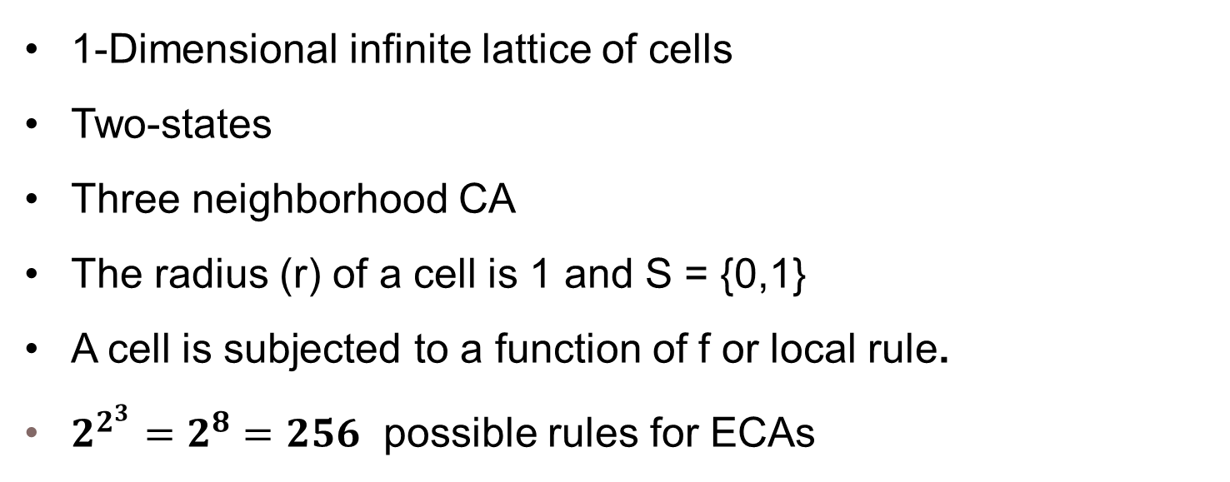
Elementary Cellular Automata
1-Dimensional infinite lattice of cells
Two-states
Three neighborhood CA
The radius (r) of a cell is 1 and S = {0,1}
A cell is subjected to a function of f or local rule.
$2^{2^{3}}=2^{8}=256$ possible rules for ECAs

Slide 16
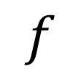
Elementary Cellular Automata
 | 111 | 110 | 101 | 100 | 011 | 010 | 001 | 000 | RULE
 | 0 | 0 | 0 | 1 | 1 | 1 | 1 | 0 | 30
 | 0 | 1 | 0 | 1 | 1 | 0 | 1 | 0 | 90
 | 1 | 0 | 1 | 0 | 0 | 0 | 0 | 0 | 160
$$f$$

Slide 17
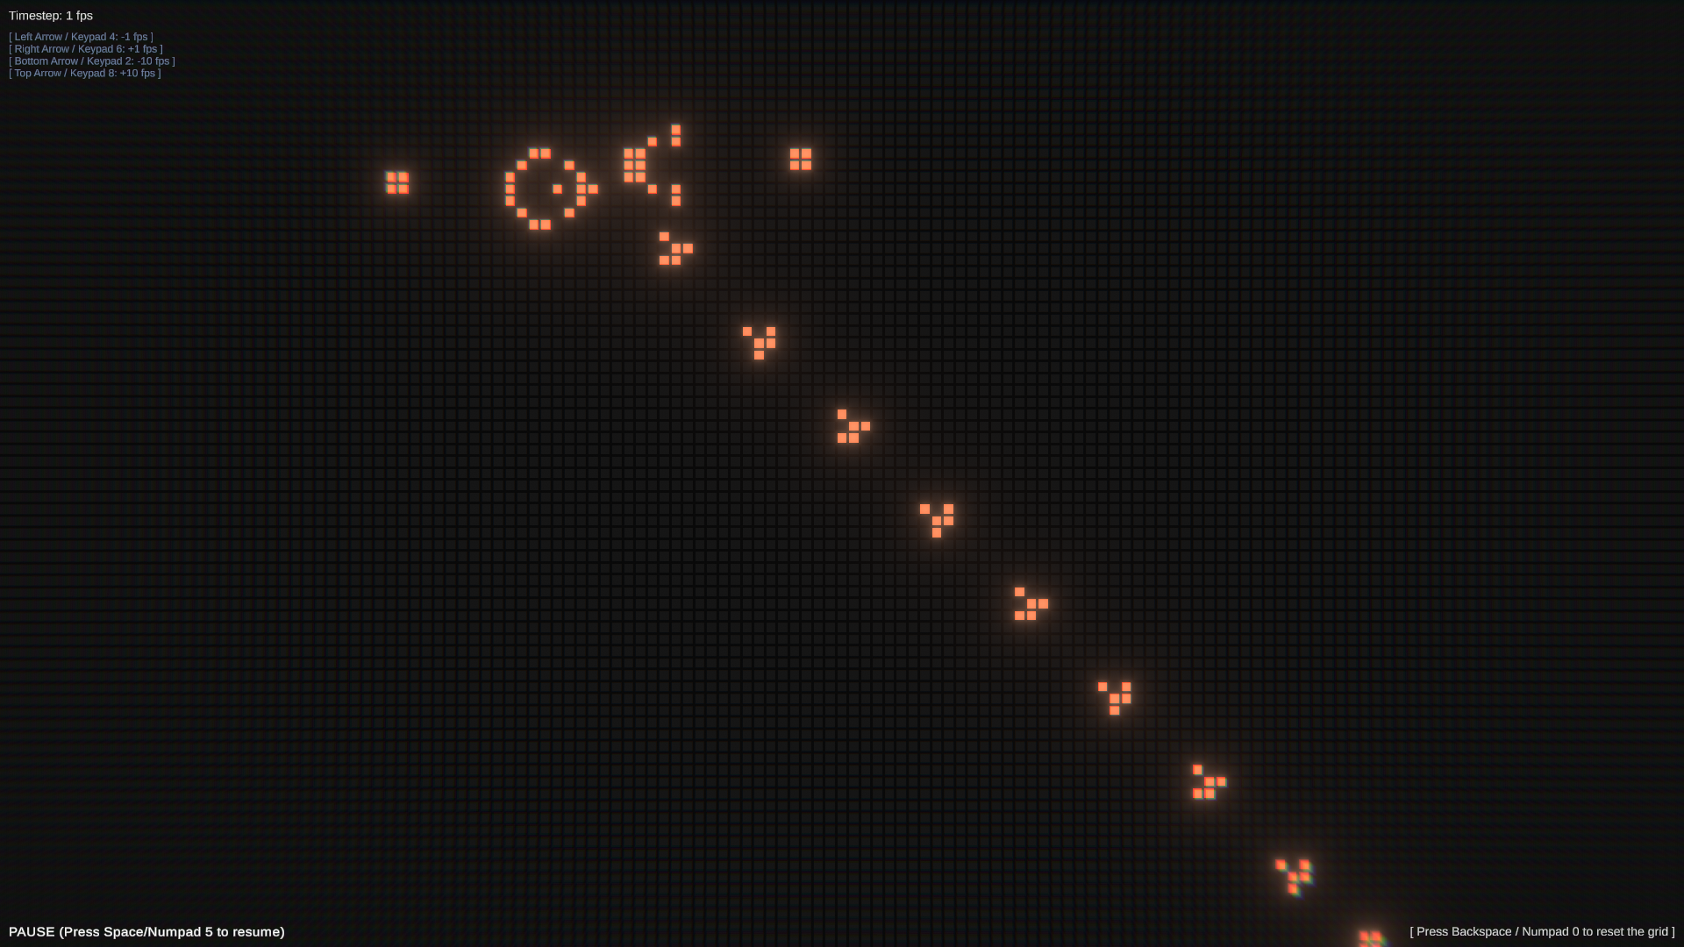
The Game of Life
The Game of Life is a classic cellular automaton created by mathematician John Conway in 1970. It simulates the birth, life, and death of cells on a two-dimensional grid, based on a simple set of rules.

Slide 18
Rules: The Game of Life
Birth:
Exactly 3 neighbor cells are live.
Death:
Overcrowding: If live neighbor cells are greater than 3 cells.
Exposure: Either 0(no neighbor) or 1 cells are live.
Survival:
Either 2 or 3 neighbor cells are live.

Slide 19
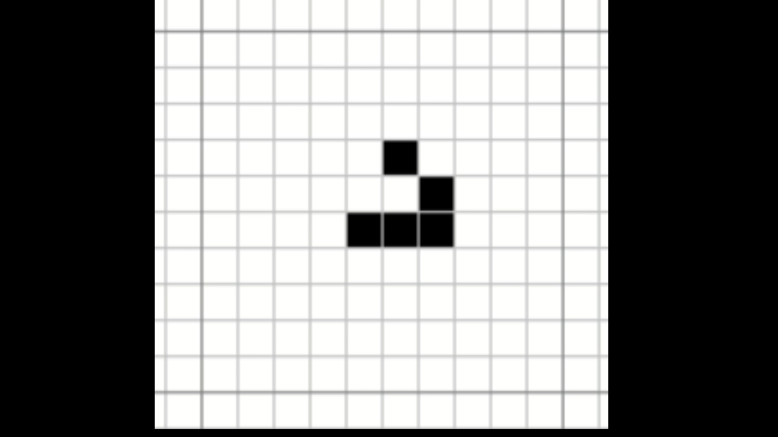

Slide 20
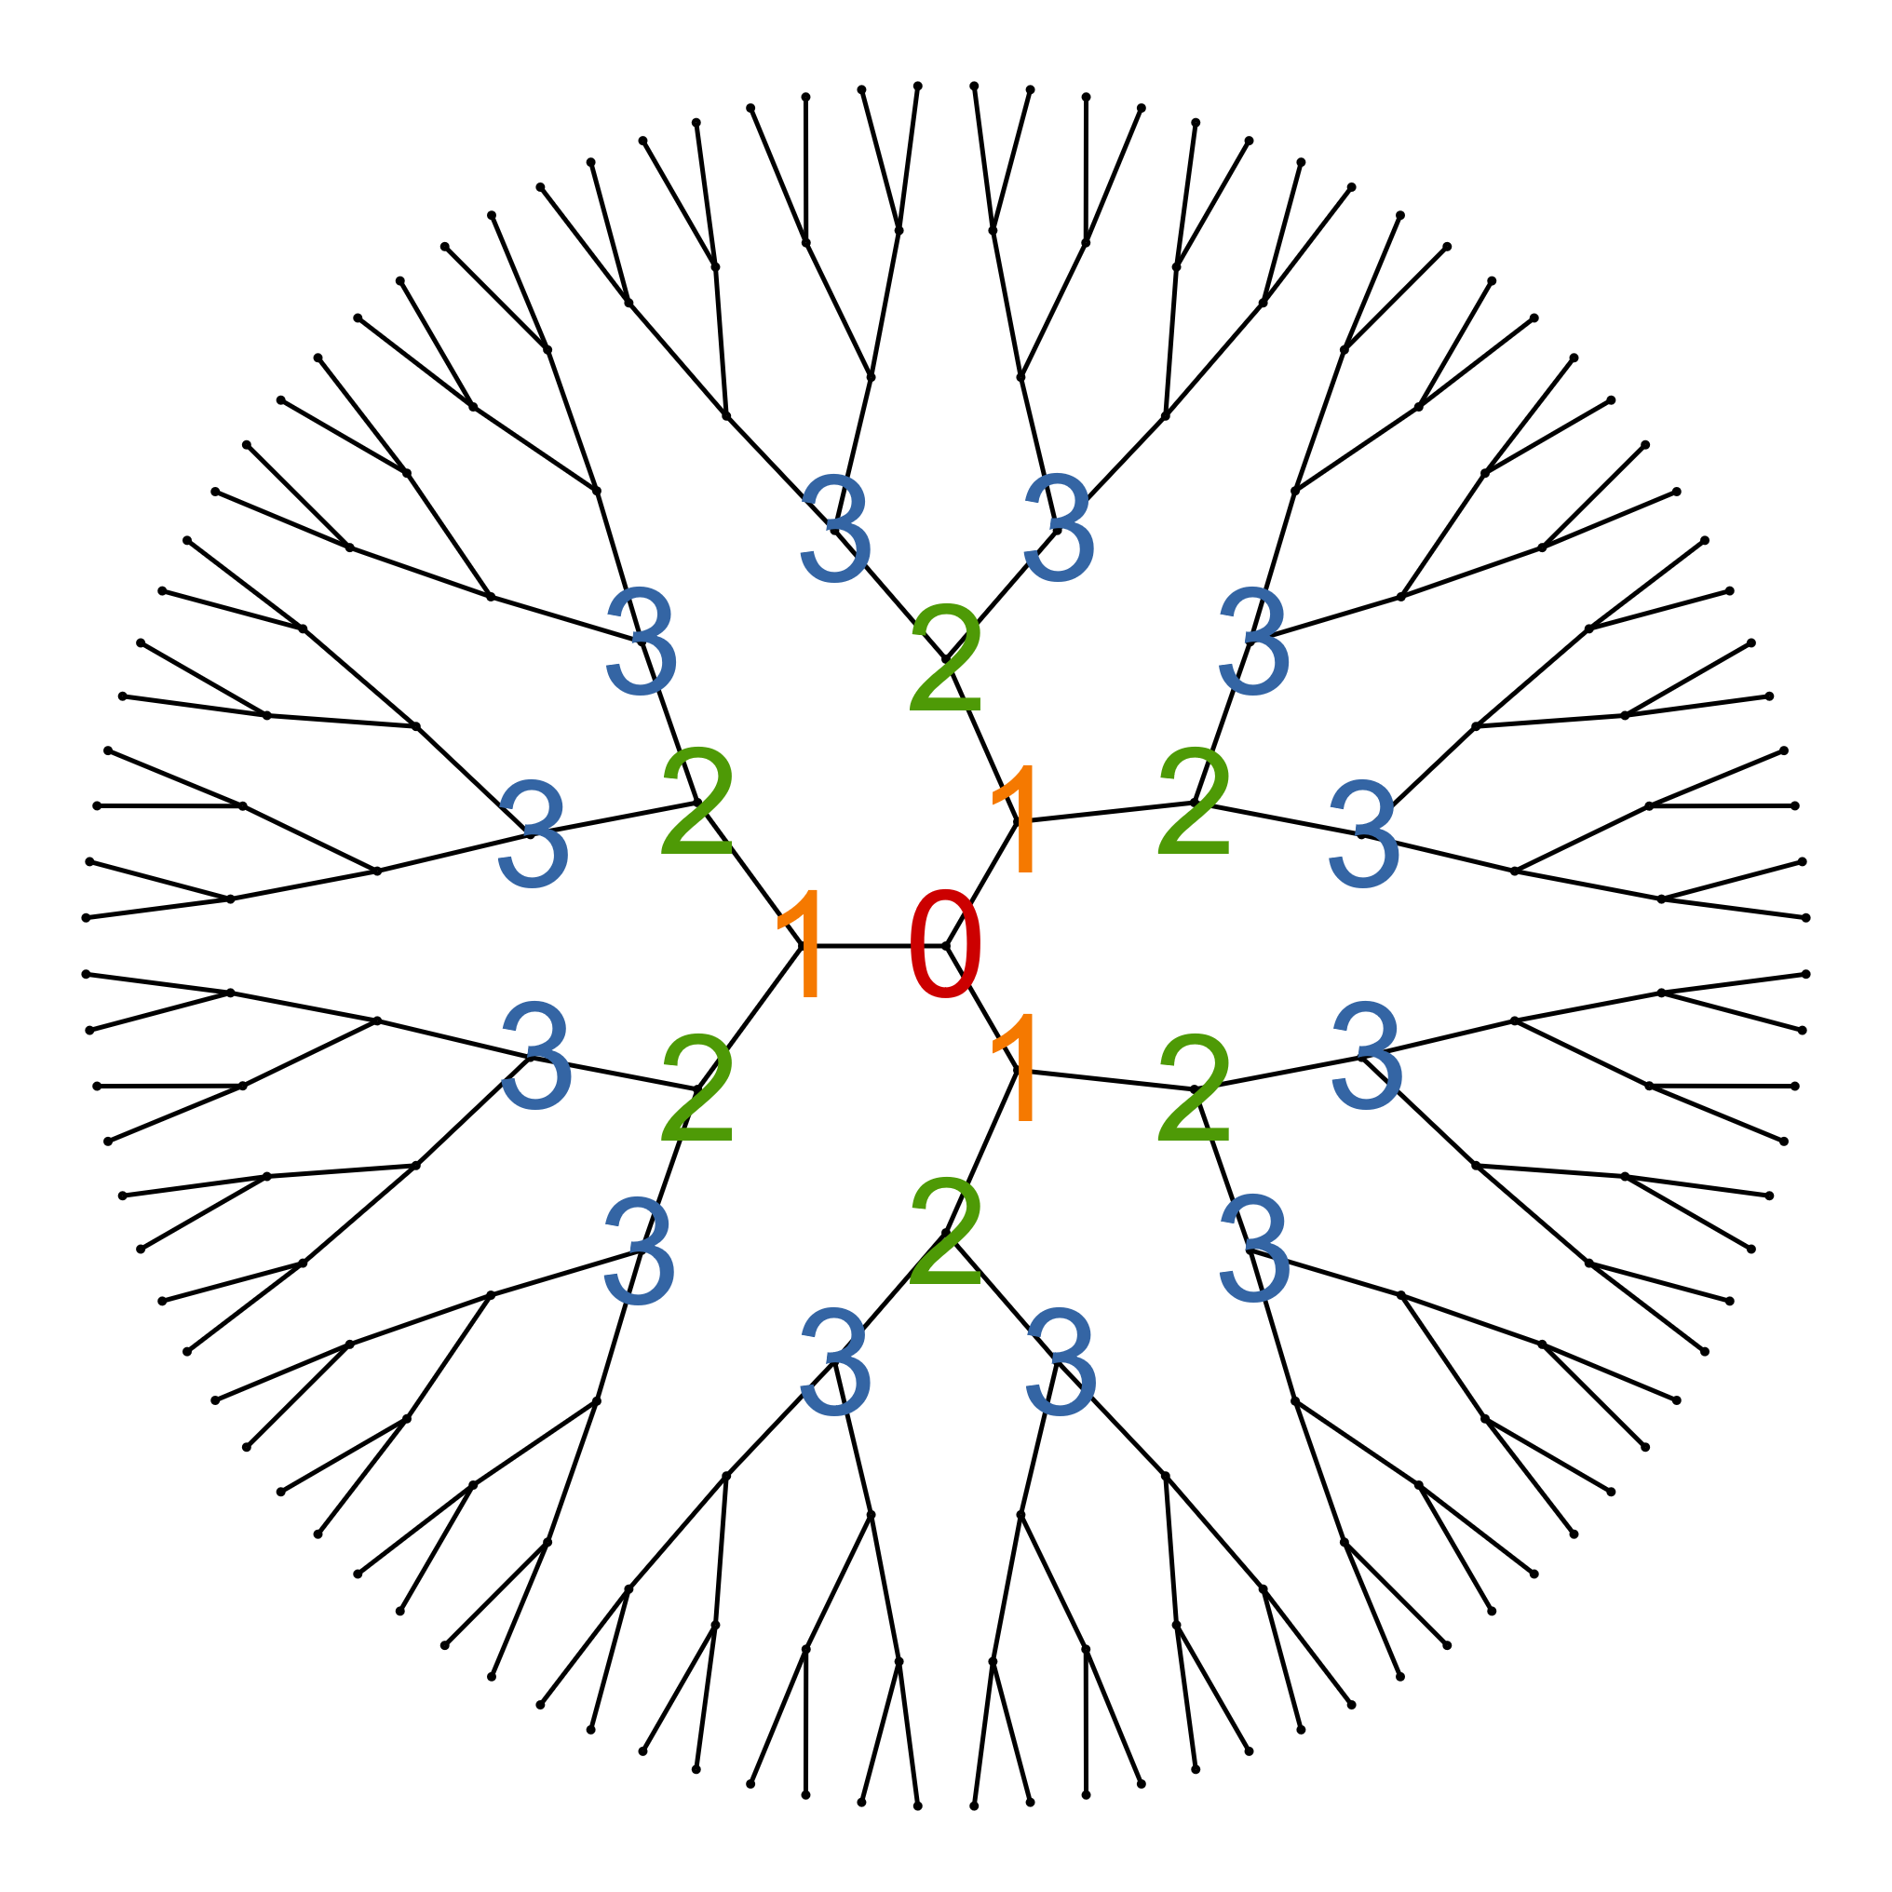
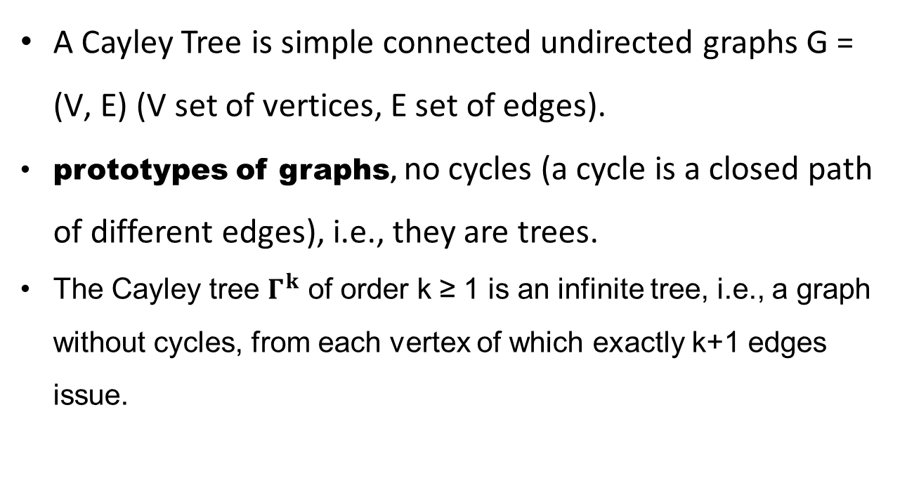
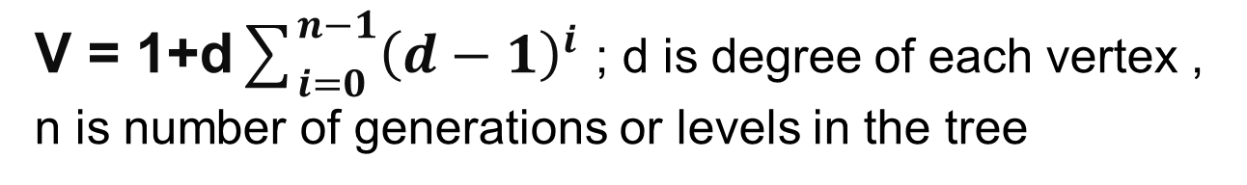
Cayley Tree
A Cayley Tree is simple connected undirected graphs G = (V, E) (V set of vertices, E set of edges).
prototypes of graphs, no cycles (a cycle is a closed path of different edges), i.e., they are trees.
The Cayley tree $Γ^{k}$ of order k ≥ 1 is an infinite tree, i.e., a graph without cycles, from each vertex of which exactly k+1 edges issue.
The number of vertices in a Cayley tree
V = 1+d$\sum_{i=0}^{n−1}{{\left(d−1\right)}^{i}}$ ; d is degree of each vertex , n is number of generations or levels in the tree
Figure : Cayley Tree
(https://en.wikipedia.org/wiki/Bethe_lattice)

Slide 21
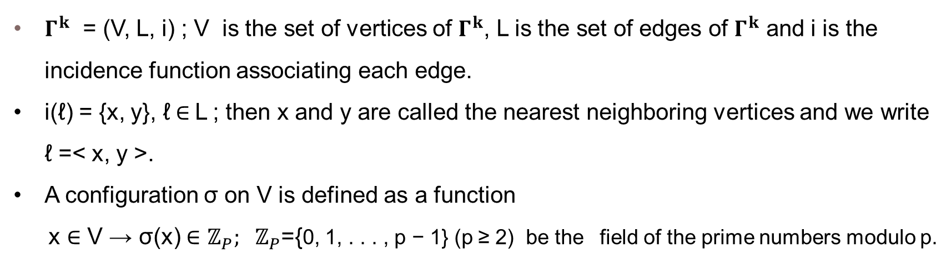
Finite CA on Cayley Tree
$Γ^{k}$ = (V, L, i) ; V is the set of vertices of $Γ^{k}$, L is the set of edges of $Γ^{k}$ and i is the incidence function associating each edge.
i(ℓ) = {x, y}, ℓ$∈$L ; then x and y are called the nearest neighboring vertices and we write ℓ =< x, y >.
A configuration σ on V is defined as a function
x ∈ V → σ(x) ∈ $ℤ_{P}; { ℤ}_{P}$={0, 1, . . . , p − 1} (p ≥ 2) be the field of the prime numbers modulo p.

Slide 22
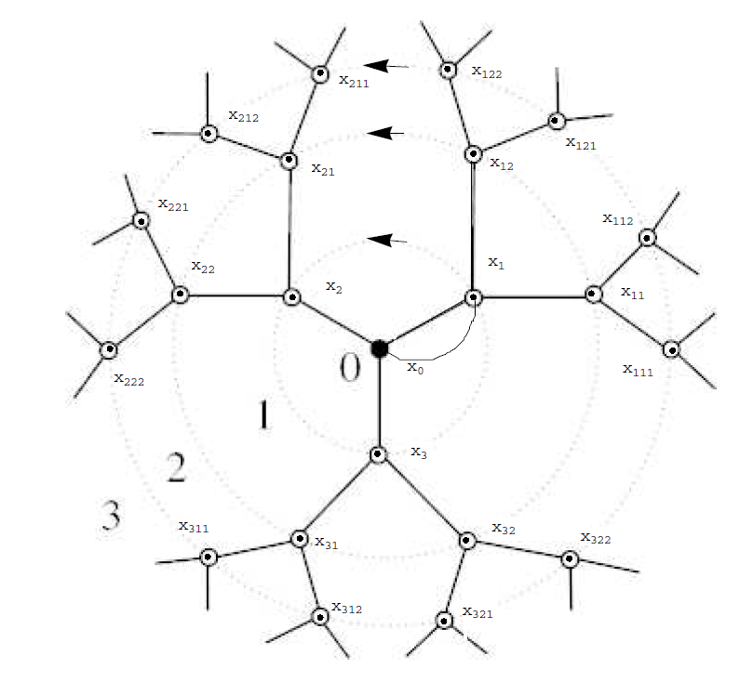
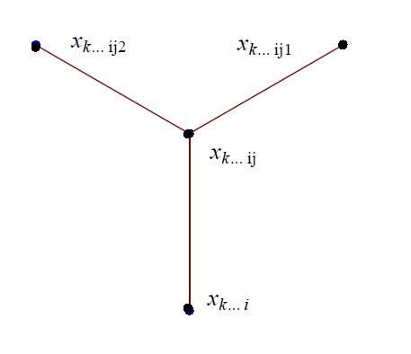
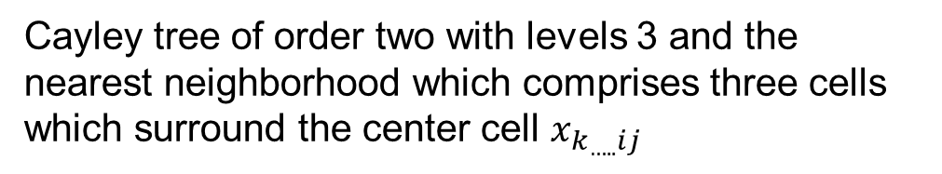
CT of Order 2, level = 3
Cayley tree of order two with levels 3 and the nearest neighborhood which comprises three cells which surround the center cell $x_{k_{…..}ij}$

Slide 23
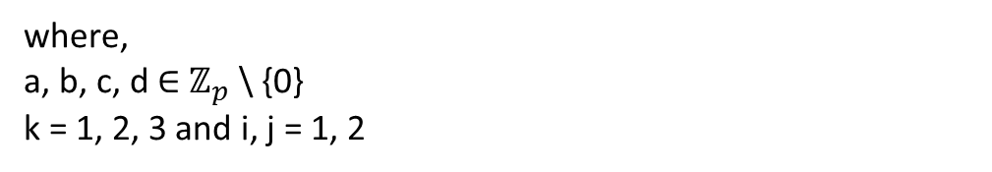
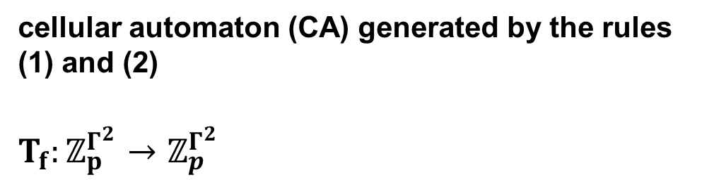
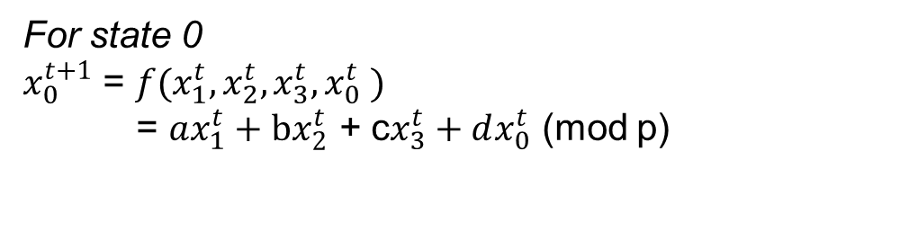
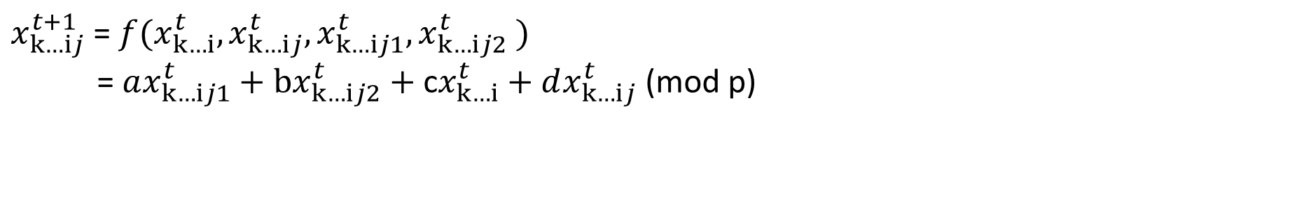
CT of Order 2, level = 3
$x_{k…ⅈj}^{t+1}$ = $f(x_{k…ⅈ}^{t},x_{k…ⅈj}^{t},x_{k…ⅈj1}^{t},x_{k…ⅈj2}^{t} )$
= $ax_{k…ⅈj1}^{t}+bx_{k…ⅈj2}^{t}\text{ + }\text{c}x_{k…ⅈ}^{t}+dx_{k…ⅈj}^{t}$ (mod p)
(1)
For state 0
$x_{0}^{t+1}$ = $f(x_{1}^{t},x_{2}^{t},x_{3}^{t},x_{0}^{t} )$
= $ax_{1}^{t}+bx_{2}^{t}\text{ + }\text{c}x_{3}^{t}+dx_{0}^{t}$ (mod p)
(2)
where,
a, b, c, d ∈ $ℤ_{p}$ \ {0}
k = 1, 2, 3 and i, j = 1, 2
cellular automaton (CA) generated by the rules (1) and (2)
$T_{f}:ℤ_{p}^{Γ^{2}}$ $→$ $ℤ_{p}^{Γ^{2}}$

Slide 24
Future Work and Discussion
Study of reversibility and convergence of CA over Cayley Tree.
These are just a few directions for future work in this field. The study of CA on Cayley trees is a rich and complex area of research with many open questions and many potential applications.

Slide 25
References
Bhattacharjee, K., Naskar, N., Roy, S., & Das, S. (2020). A survey of cellular automata: types, dynamics, non-uniformity and applications. Natural Computing, 19, 433-461.
Conway's Game of Life - Cellular Automata by PtitPoly (itch.io)
Conway's Game of Life (conwaylife.com)
Dalai, A., & Paul, S. (2023, March). Layered Cellular Automata and Pattern Classification. In Asian Symposium on Cellular Automata Technology (pp. 127-141). Singapore: Springer Nature Singapore.
AKIN, H. (2012). Cellular automata on cayley tree. arXiv preprint arXiv:1211.7362.
Simple but Stunning: Animated Cellular Automata in Python | iSquared

Slide 26
THANK
YOU

